Slide 1

Voice to text project

Slide 2
Objectives
Compare different voice to text engines
Train a machine learning algorithm to label conversations as compliant or not compliant

Slide 3
Phase 1 - Comparing Engines
Engines Compared:
Amazon Speech to text
IBM Watson
Google Cloud Speech
Microsoft Azure
Twilio
Speechmatics
Trint

Slide 4
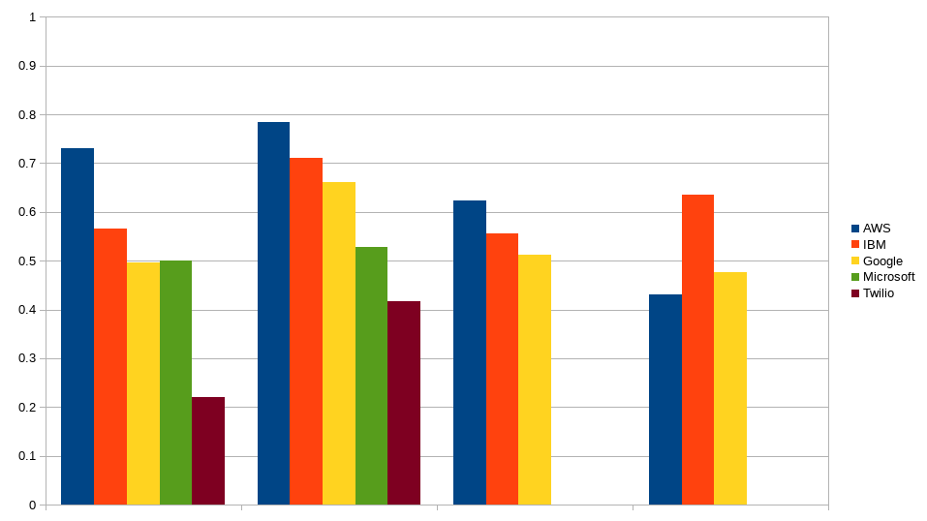
Phase 1 – Results
Word similarity letter similarity word similarity with speakers letter similarity with speakers

Slide 5
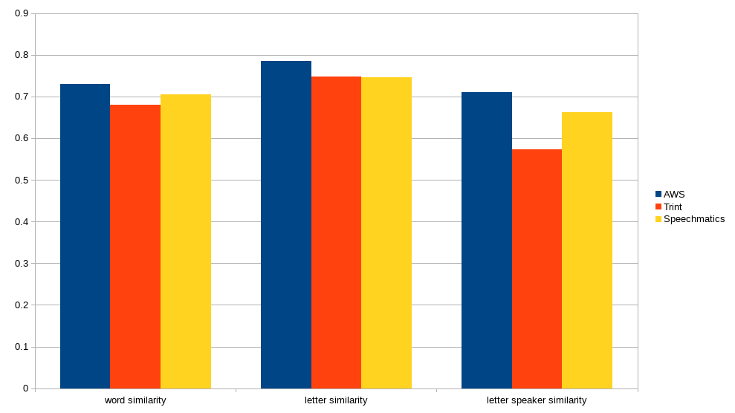
Phase 1 – further results

Slide 6
Phase 1 – observations
AWS:
Highest average in each category
Letter accuracy not hugely affected by speaker diarization
Pretty consistent across conversations
IBM:
Best at consistently transcribing every sentence
Very good at almost getting words correct
Accuracy affected least by speaker diarization
Google:
Missing random chunks of text
Incredibly accurate for sections transcribed
Best at correctly identifying different speakers
Microsoft:
Sentences either transcribed perfectly or completely wrong
Sometimes missing chunks of text
Speaker diarization difficult to activate

Slide 7
Phase 1 – observations
Speechmatics:
Accuracy very high
Speaker diarization needs improving
Trint:
Accuracy very high
Most affected by speaker diarization
Twilio:
Low accuracy (maybe due to poor audio quality)
No speaker diarization at this time
Cannot transcribe conversations longer than 2 minutes

Slide 8
Phase 2 – Training a machine learning model
Two methods were tested:
Looking for key compliance words
Looking at sentence structure

Slide 9
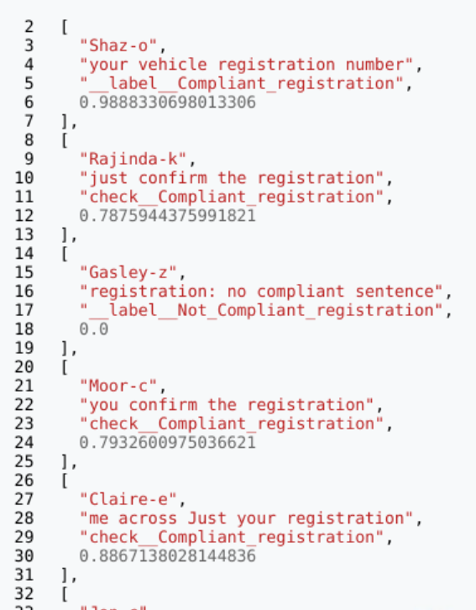
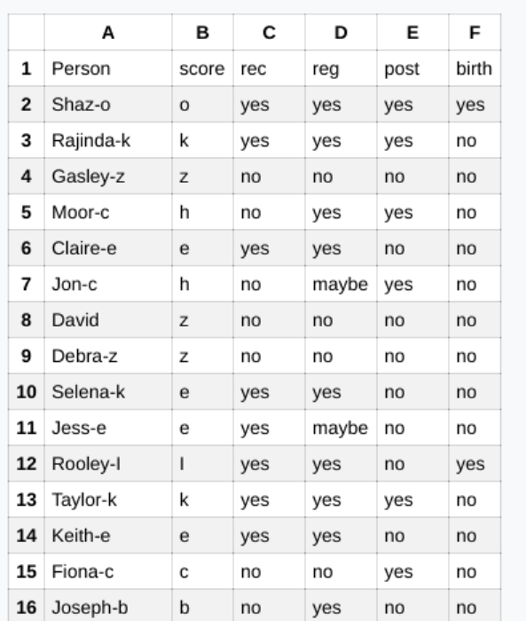
Phase 2 – method 1 – Output

Slide 10
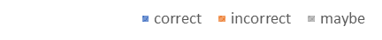
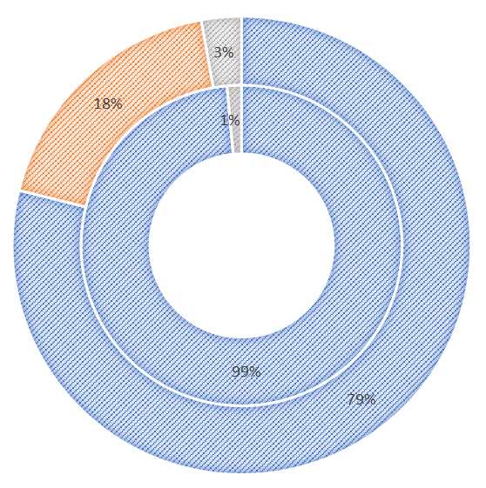
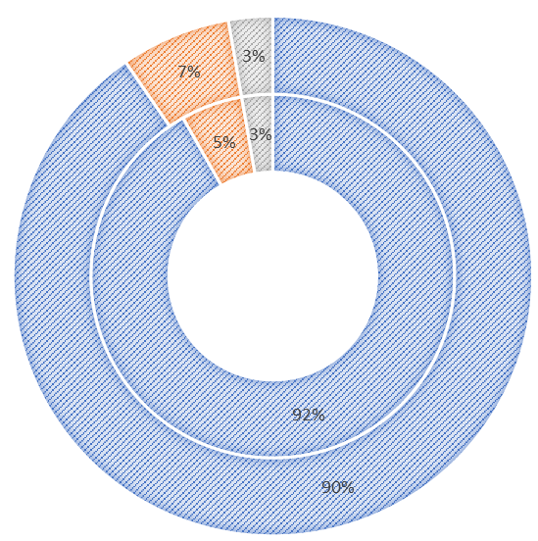
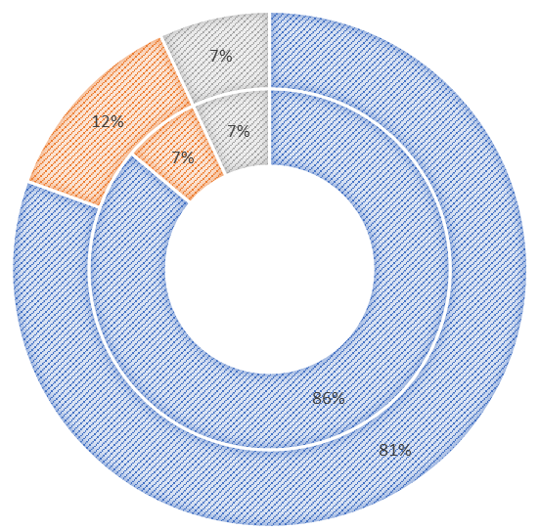

Phase 2 – method 1 – Individual Test accuracy
This Call Is Being Recorded
Confirmation of Post Code
Confirmation of Registration Number
Confirmation of Date of Birth

Slide 11
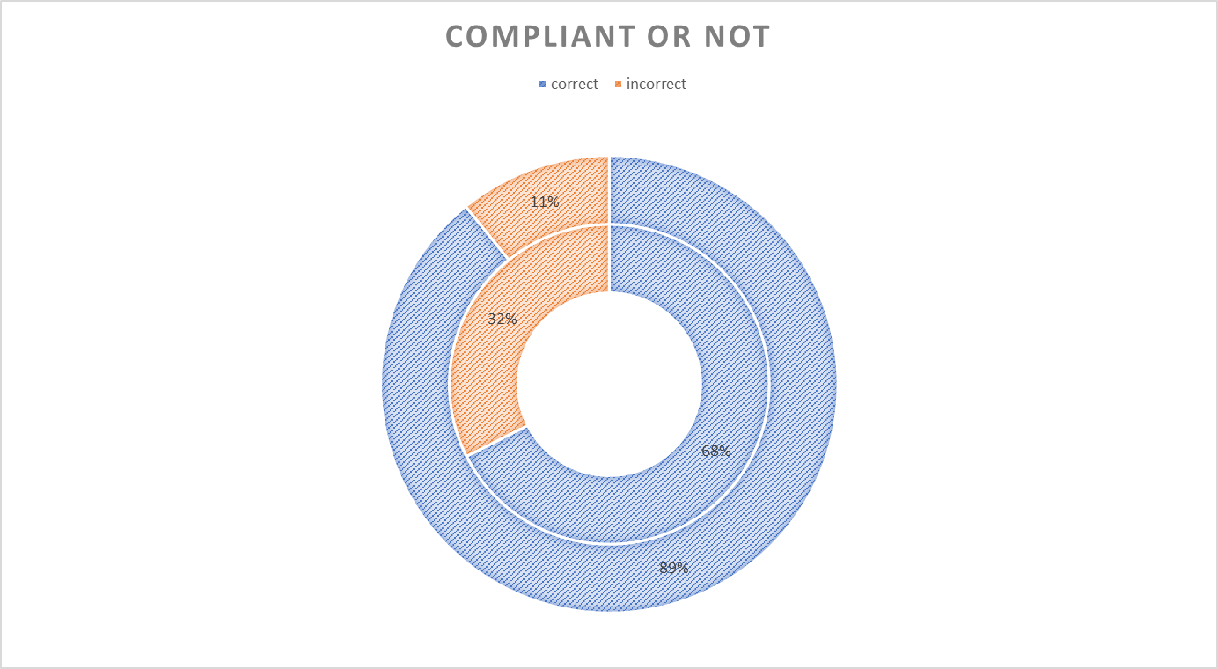
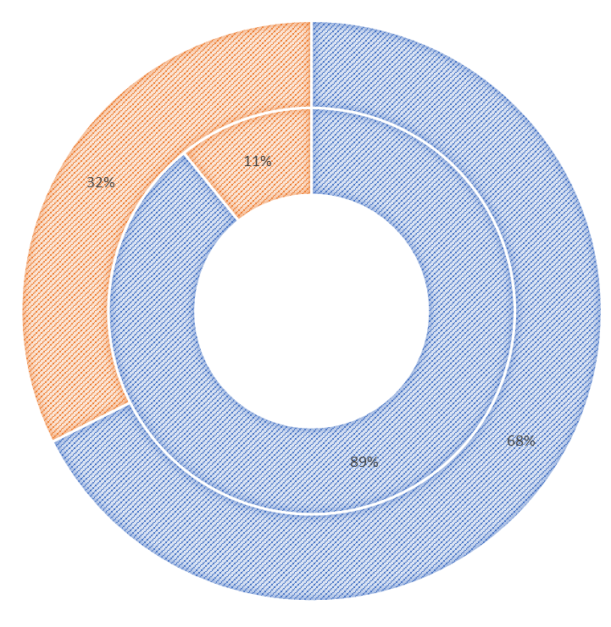
Phase 2 – method 1 – Overall accuracy

Slide 12
Phase 2 – method 1 - overview
Short phrases, typically 4-5 words in length, look for key compliance words
The training data matches with possible labels exactly
Pros:
Model easy to train and retrain
Over 95% accurate when the transcription is accurate
Likely to become more accurate once the transcription engine has been trained in key words
Cons:
Only as good as the transcription quality
Less accurate if key words are used elsewhere in the conversation

Slide 13
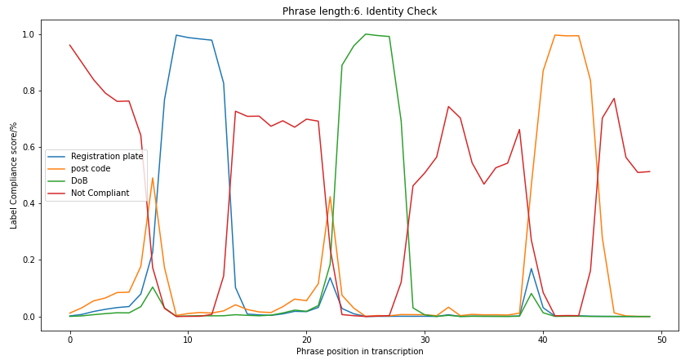
Phase 2 – Method 2 - output

Slide 14
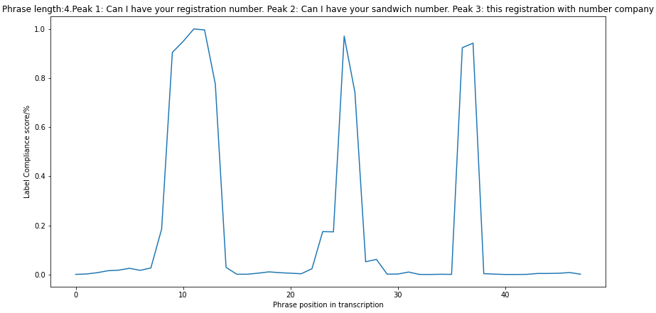
Phase 2 – Method 2 – The effect of changing phrase length

Slide 15
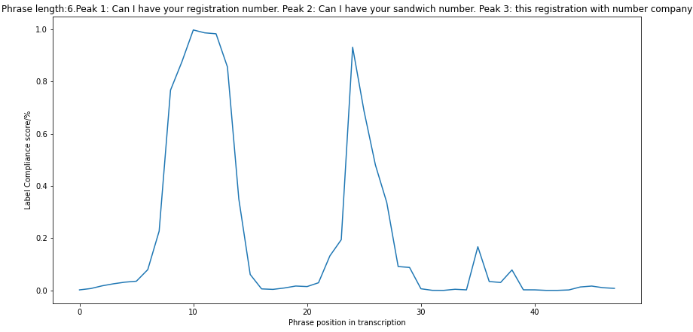
Phase 2 – Method 2 – The effect of changing phrase length

Slide 16
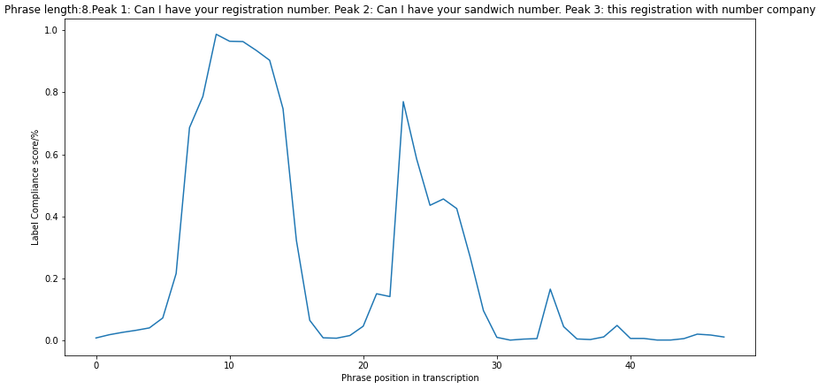
Phase 2 – Method 2 – The effect of changing phrase length

Slide 17
Phase 2 – Method 2 – The effect of changing phrase length
Longer phrases, typically 6-8 words in length, look at sentence structure of compliant sentences
The training data does not always match the possible labels
Pros:
Good at mitigating transcription errors
Possibility of further development (signal smoothing, constant training)
Cons:
Not complete – current bug
More difficult to train

Slide 18
Next phase– Recommendations for the future
Train the AWS custom dictionary
Further training of both models by looking at incorrect labels
Smoothing of data to remove false positives
Train model 2 with poor transcription sentences
Investigate possible other machine learning models
Investigate possible other voice recognition software
Consider Microsoft, if viable

